Slide 1



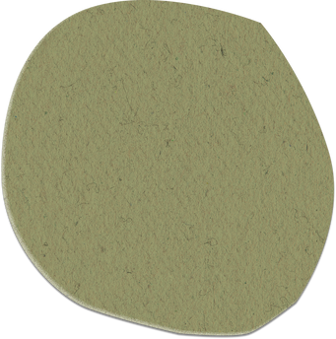




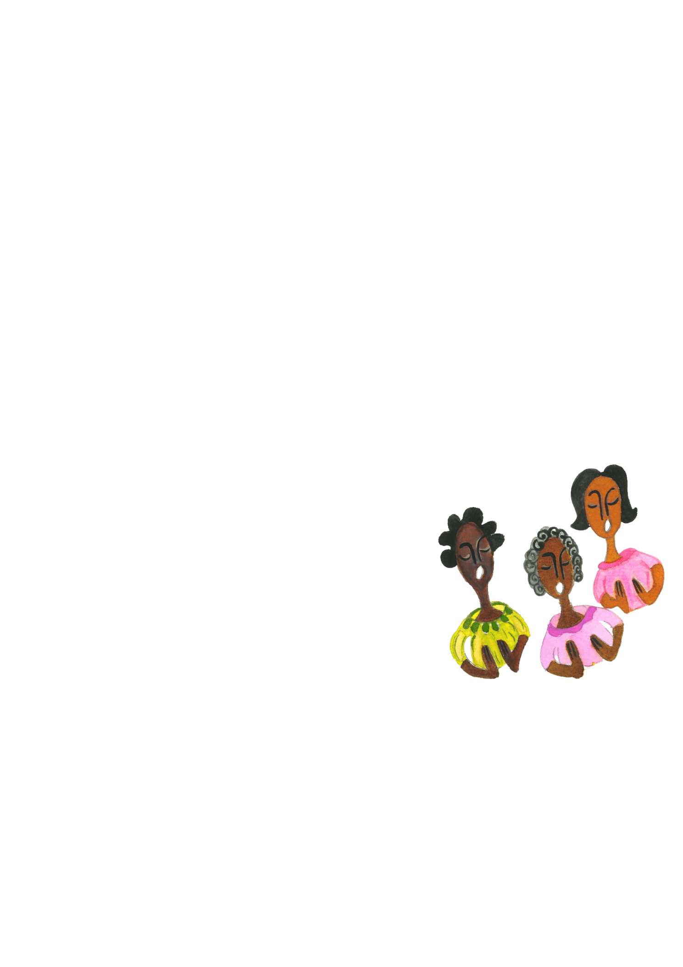
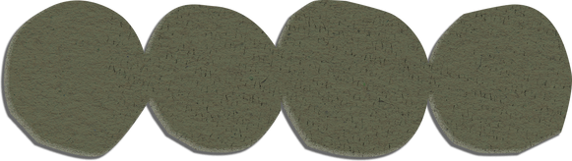
WINDRUSH
WONDER ART
an introduction
Illustration by Michelle Inniss

Slide 2

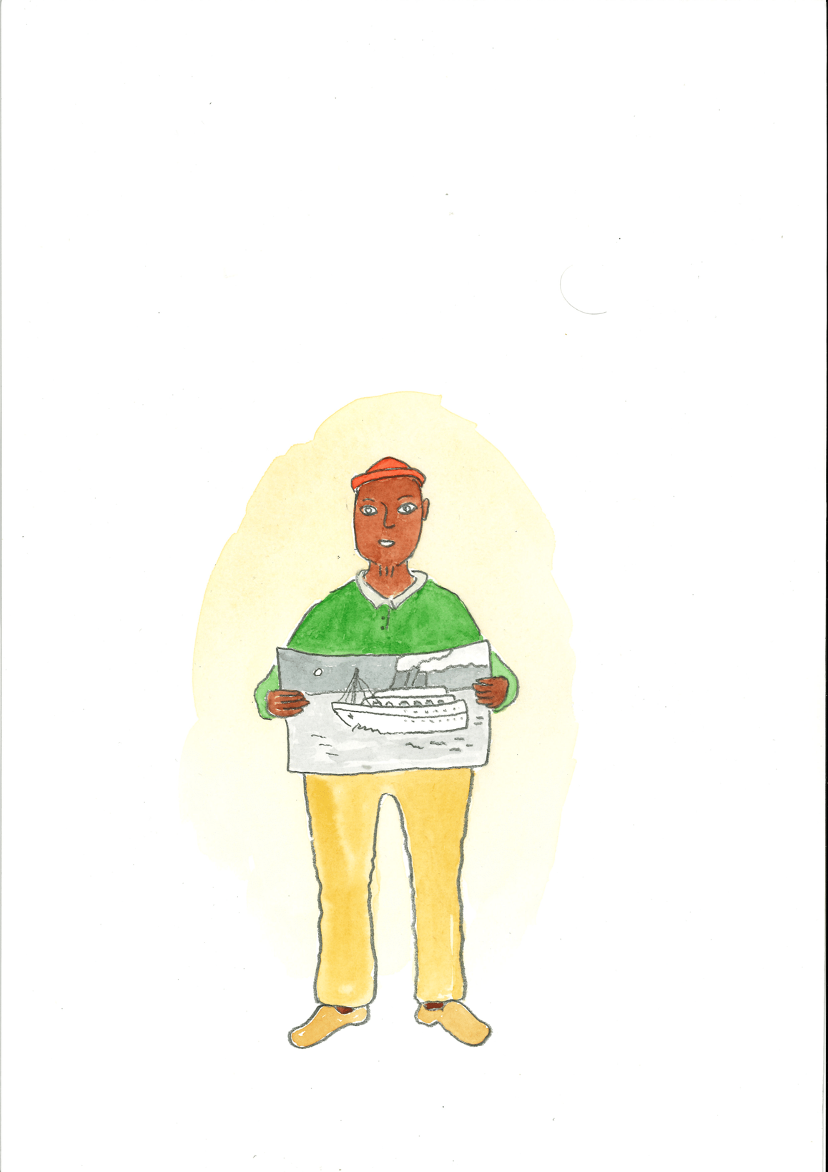



A journey from somewhere familiar to somewhere new
Illustration by Enrique Gavilanes

Slide 3

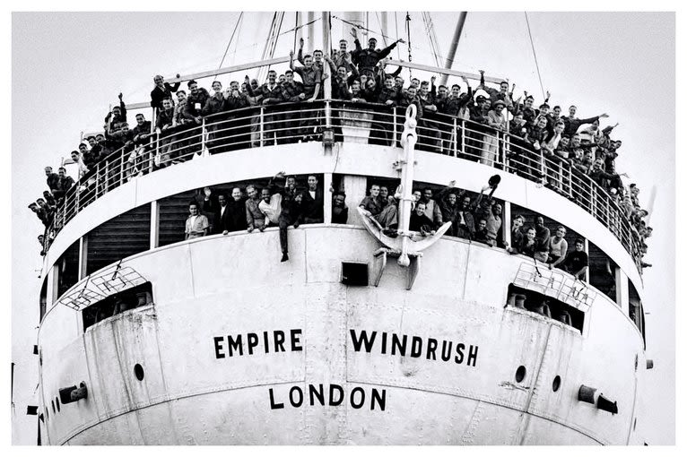


Slide 4
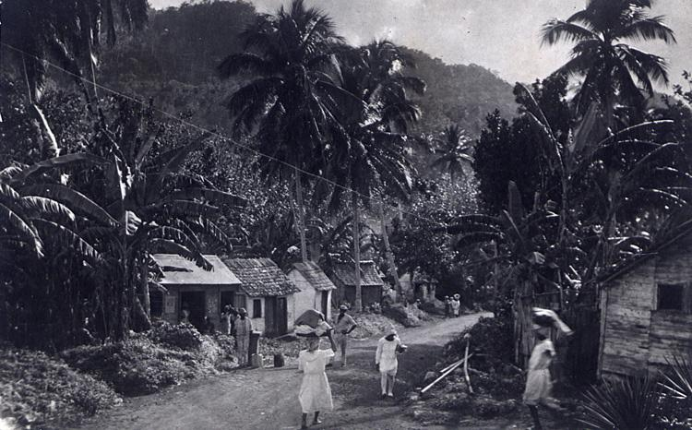
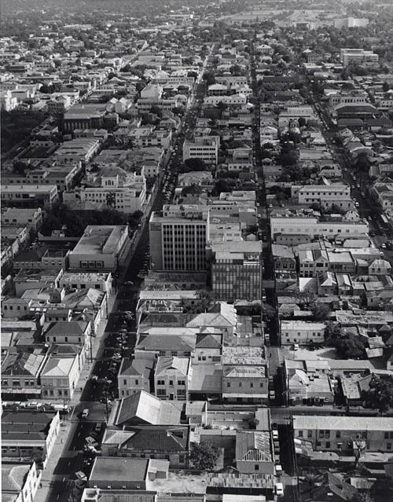
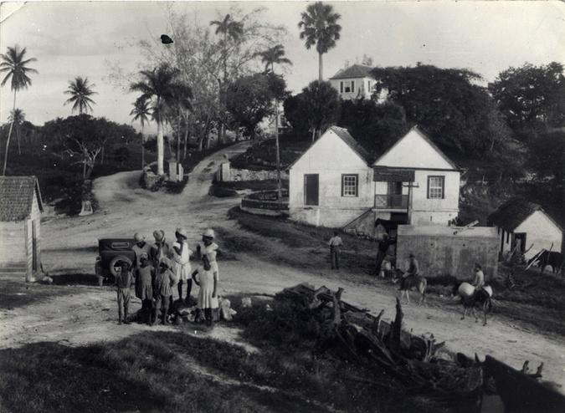

Jamaican village scene c1950
Jamaican village scene c1950
What do you notice?
A large Jamaican city c1950
Jamaican estate c1940s

Slide 5
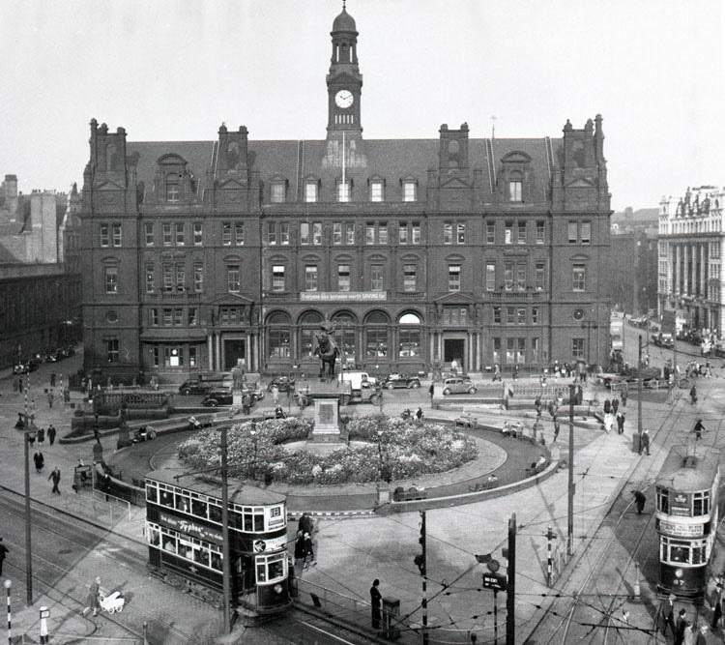
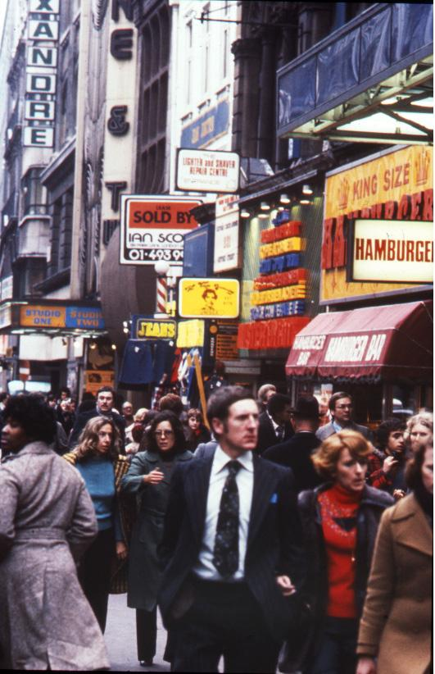
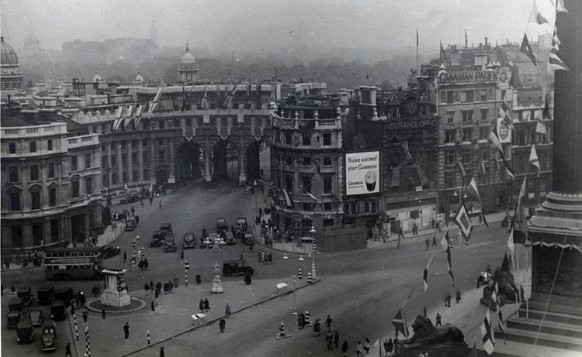
City Square Leeds, 1949
City Square Leeds, 1949
What are the differences?
Trafalgar Square London 1946
Oxford Street, London 1960s

Slide 6
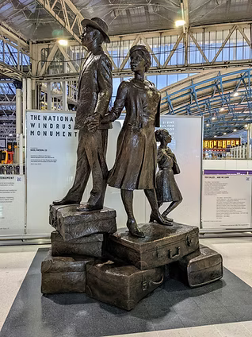







Journeys to Hope
Windrush Narratives
SHARING THE JOURNEY OF THE WINDRUSH GENERATION BEFORE, DURING AND AFTER ARRIVING IN THE UK
These important photographs, alongside their stories, are now part of Autograph’s permanent Collection of Photography that aims to preserve the legacy of important narratives that have contributed to British history.

Slide 7
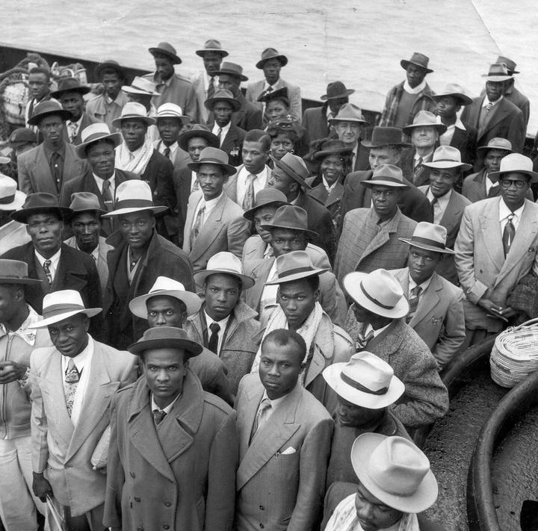
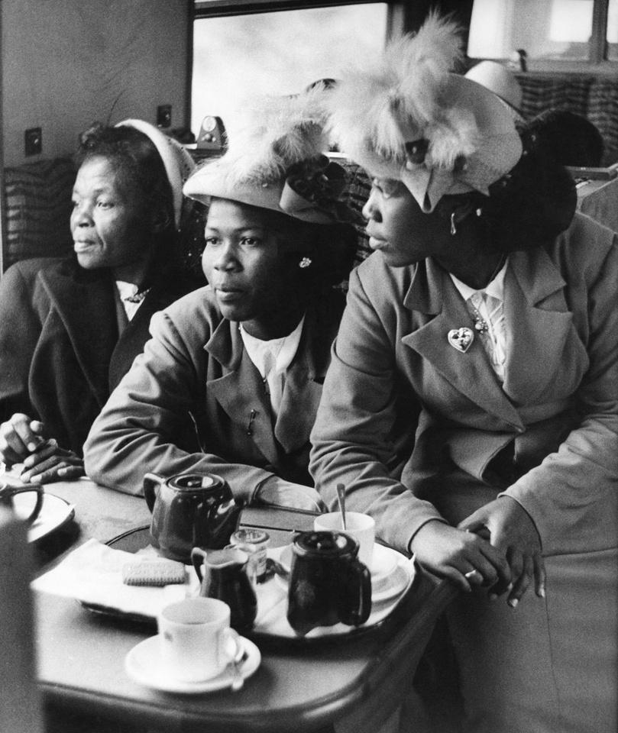
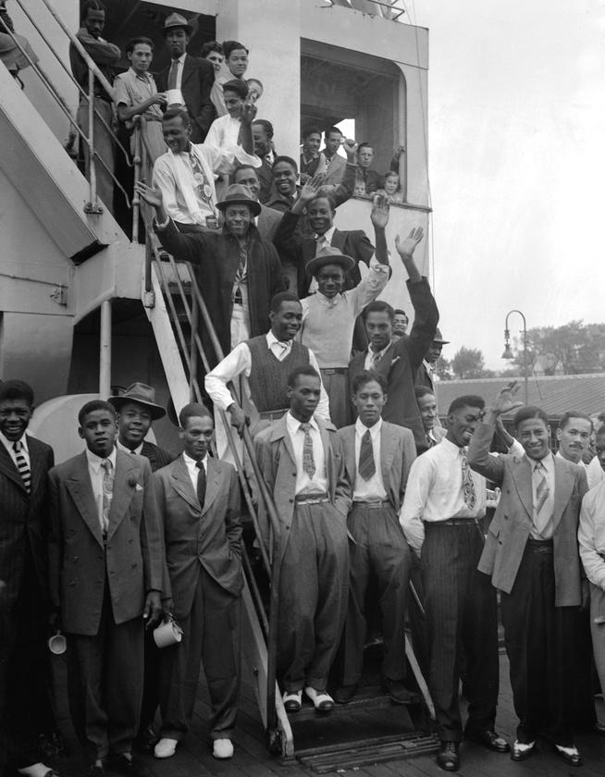
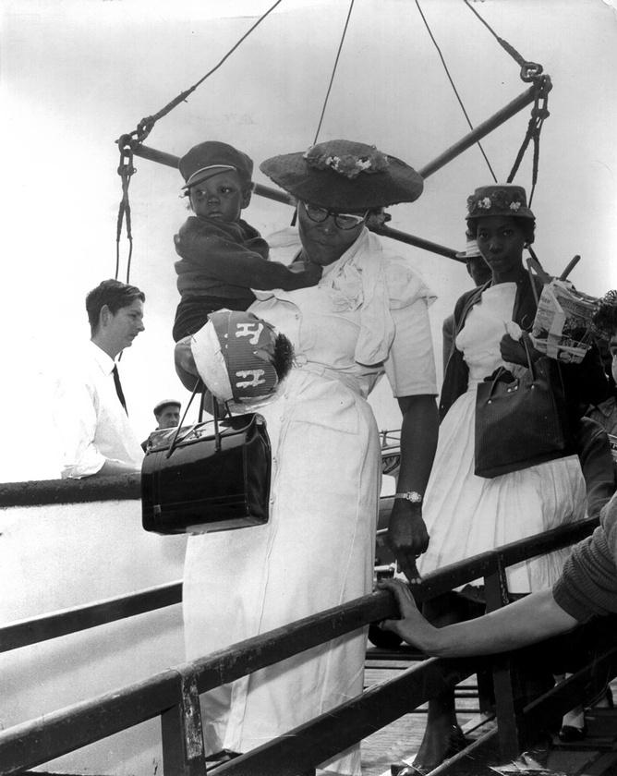
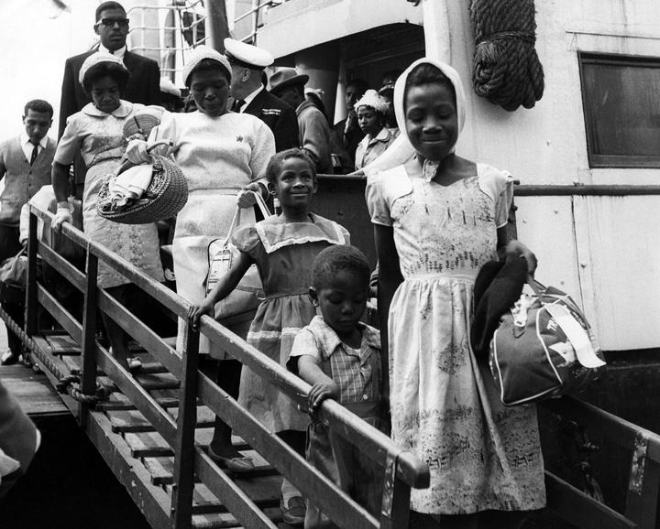
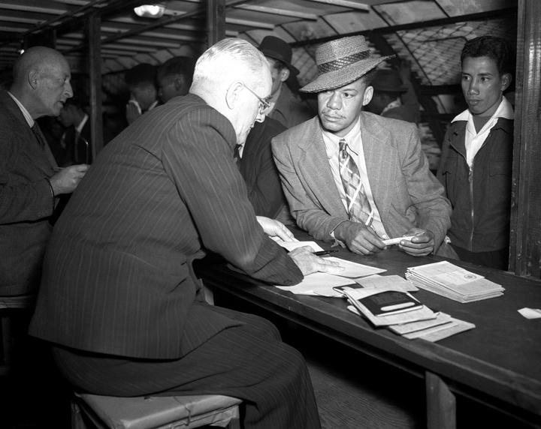
What strikes you about these images?

Slide 8


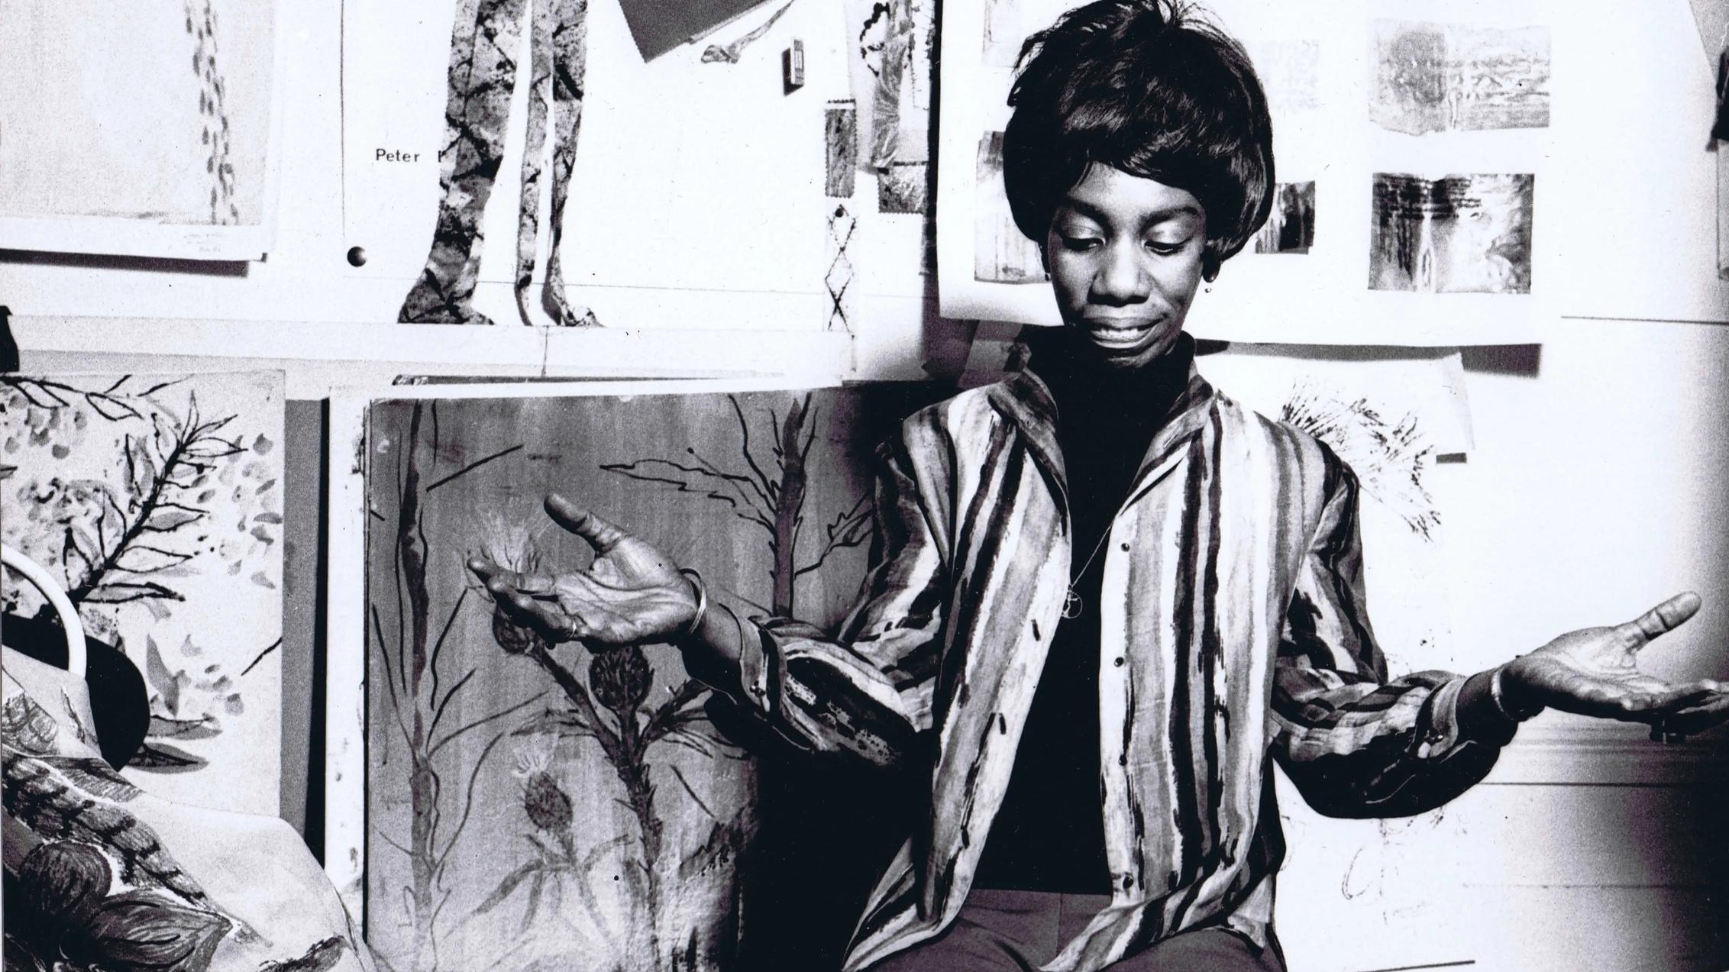


ALTHEA IN THE 1970S
Althea McNish
Althea McNish (1924 – 2020) was amongst the first, if not the first, designer of African-Caribbean descent to achieve international recognition. Her designs injected much-needed colour and life into the post-war fashion and textiles industry from the 1950s onwards.
What do you see?
REPEATING
PATTERNS
Everything I did, I saw it through a tropical eye.”
– Althea McNish, 2015
COLOURS
SHAPES
TEXTURES
INSPIRATIONS

Slide 9
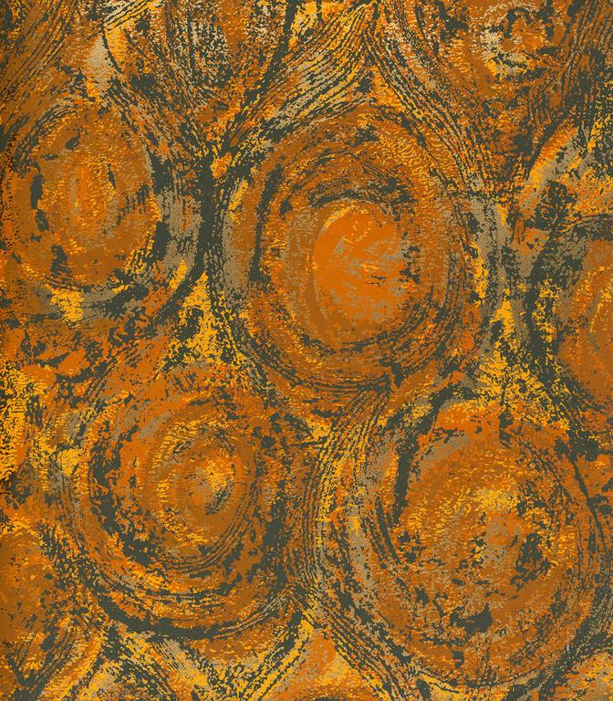
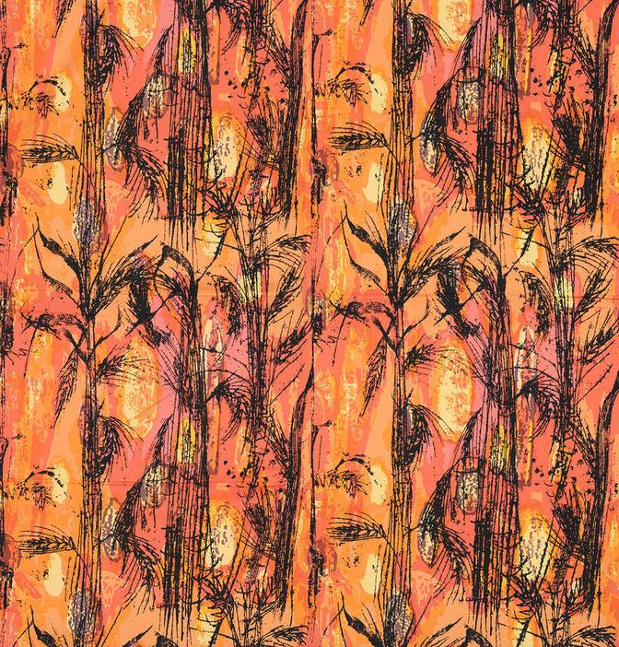
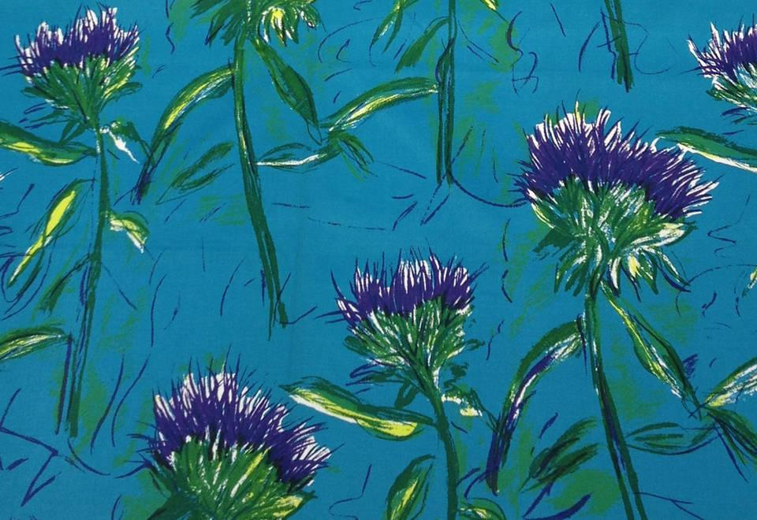
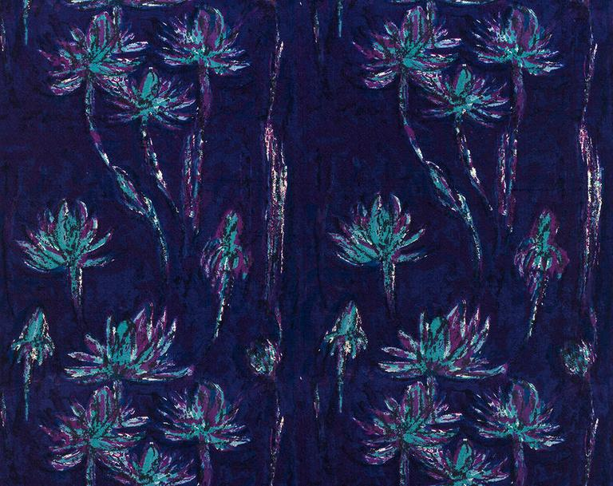
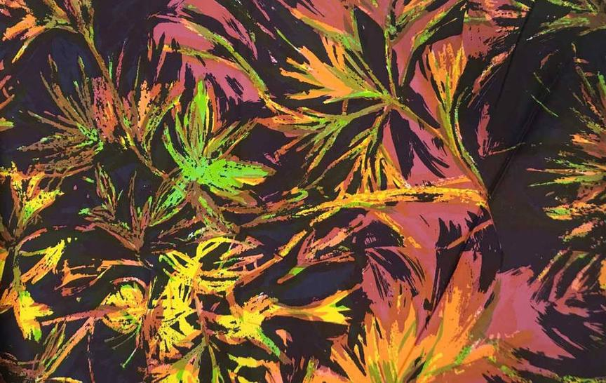
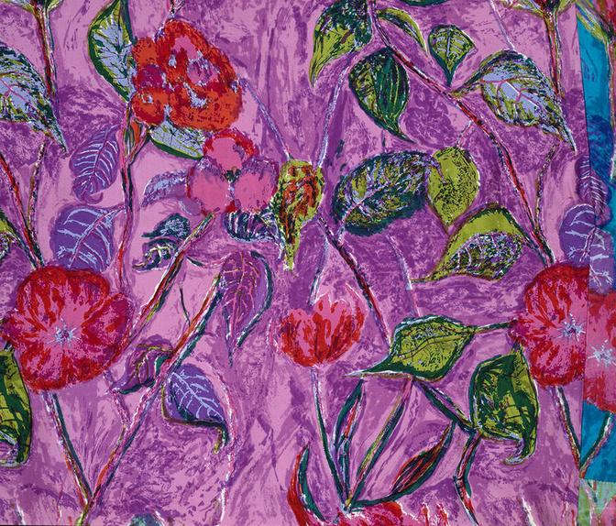
Where are the landscapes from in these patterns?
What about the colours?

Slide 10



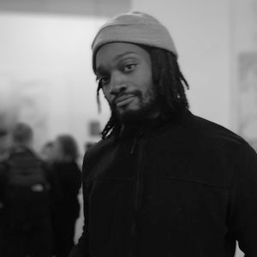

Deanio X
  Contemporary response art to Windrush
2. Graffiti artist and painter who collaborates with other artists and people from the community
3. FRESH OFF THE BOATS: Considering the symbolism of the boat as a timeless vessel for the transportation of bodies and ideas.

Slide 11
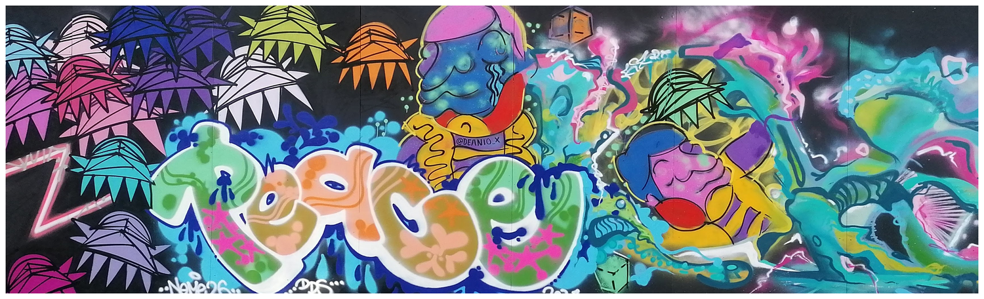
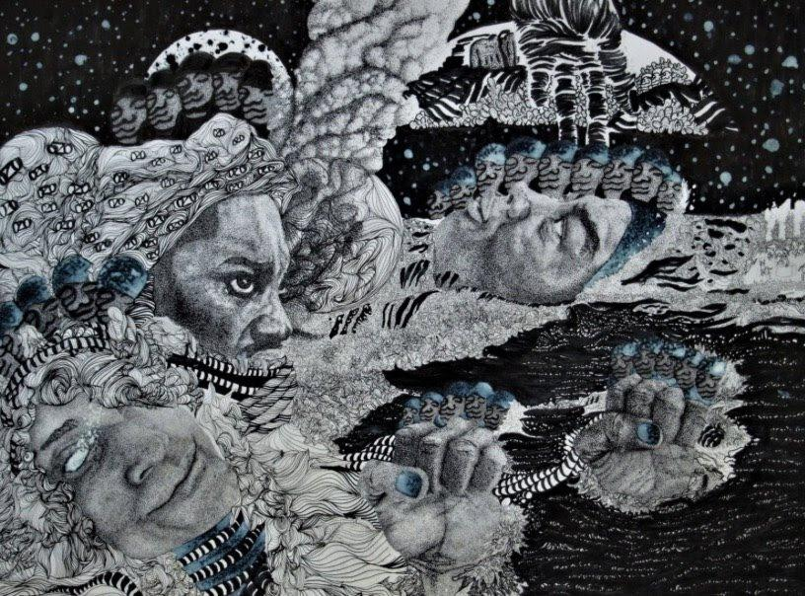
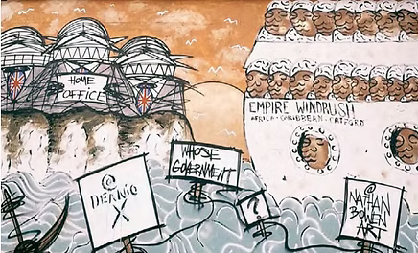

Slide 12


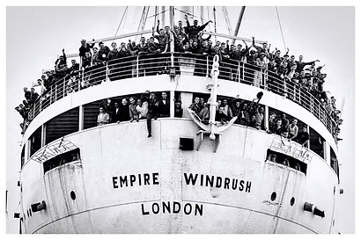




Making a moodboard
Feel – what feeling does your moodboard capture/create
Colours, shapes, patterns, imagery
Words and phrases
Composition – how does it fit together on the page

